Slide 1
Object Oriented Programming
Simple Class & Objects

Slide 2
Concepts
Class
Object
Attributes and Operations
Accessing Class Fields and Methods
Public , Private , Protected
Class and Instance variables & functions
Primitive Type vs Object/Reference Type
Static vs Non-Static
Arrays of Primitive & Object type

Slide 3
Class & Object
A CLASS is a template (specification, blueprint) for a collection of objects that share a common set of attributes and operations.
A Class is a blueprint or prototype from which objects are created
Object is an instance of a Class that is Instantiated/created with new operator in java/C#/VC.
http://docs.oracle.com/javase/tutorial/java/index.html

Slide 4
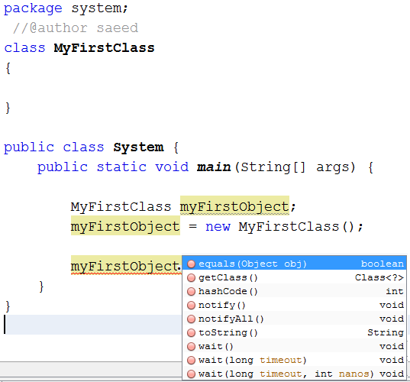
MyFirstClass
Empty Class contains nothing but it is still derived from Object Class by default in java

Slide 5
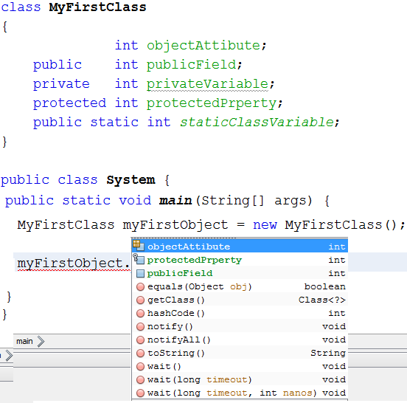
MyFirstClass
objectAttibute; +publicField:int -privateVariable:int #protectedPrperty:int +staticClassVariable:int
Instance/Object Variable
Class Variables

Slide 6
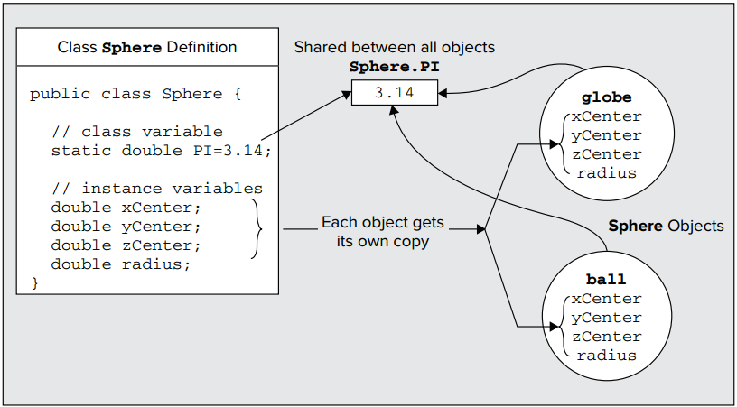
Another Example

Slide 7
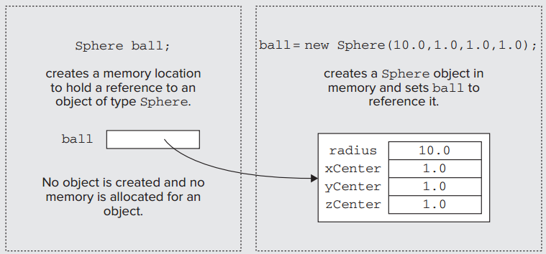
Declaration vs Definition

Slide 8
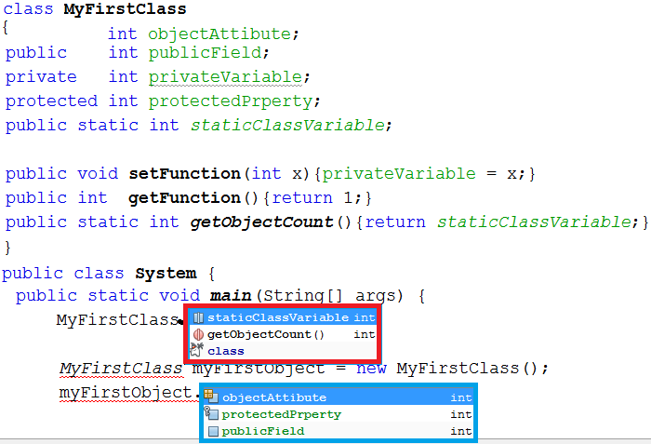
MyFirstClass
objectAttibute; +publicField:int -privateVariable:int #protectedPrperty:int +staticClassVariable:int
+setFunction(int x) +getFunction():int +getObjectCount():int

Slide 9
Access Attributes
ATTRIBUTE | PERMITTED ACCESS
No access attribute | From methods in any class in the same package.
Public | From methods in any class anywhere as long as the class has been declared as public.
Private | Accessible only from methods inside the class. No access from outside the class at all.
Protected | From methods in any class in the same package and from any subclass anywhere.

Slide 10
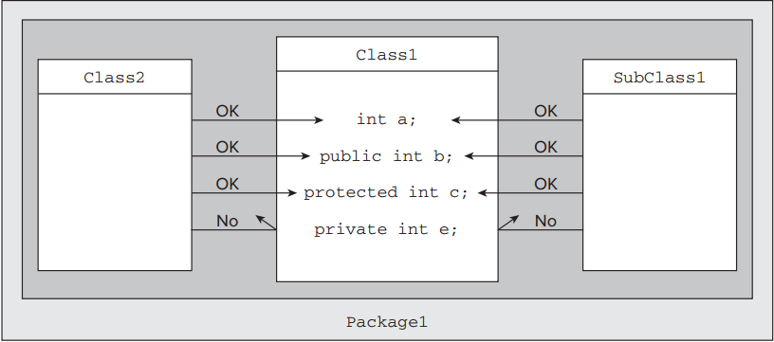
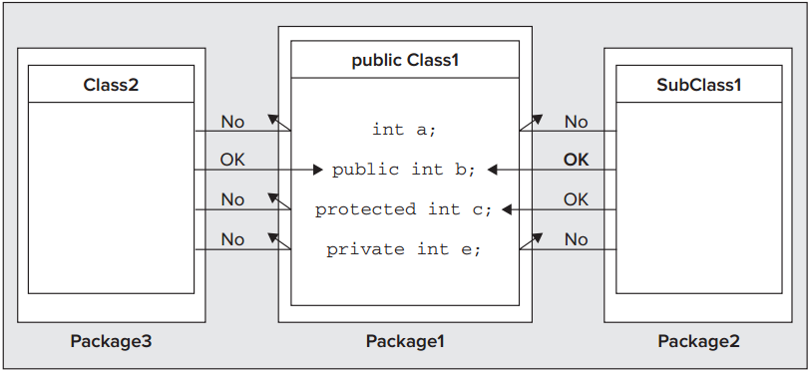

Slide 11
Summary
Concept | Definition
Class | A class deﬁnition speciﬁes the variables and methods that are members of the class.
Class Variables | Class variables are declared using the keyword static, and one instance of each class variable is shared among all objects of a class.
Instance Variables | Each object of a class has its own instance variables — these are variables declared in the class without using the keyword static.
Static Methods | Methods that are speciﬁed as static can be called even if no class objects exist, but a static method cannot refer to instance variables
Non-Static Methods | Methods that are not speciﬁed as static can access any of the variables in the class directly.
Class Member Access | Access to members of a class is determined by the access attributes that are speciﬁed for each of them. These can be public, private, protected, or nothing at all.

